Slide 1
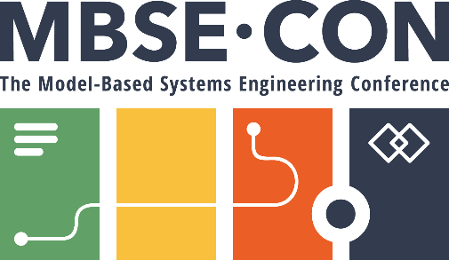
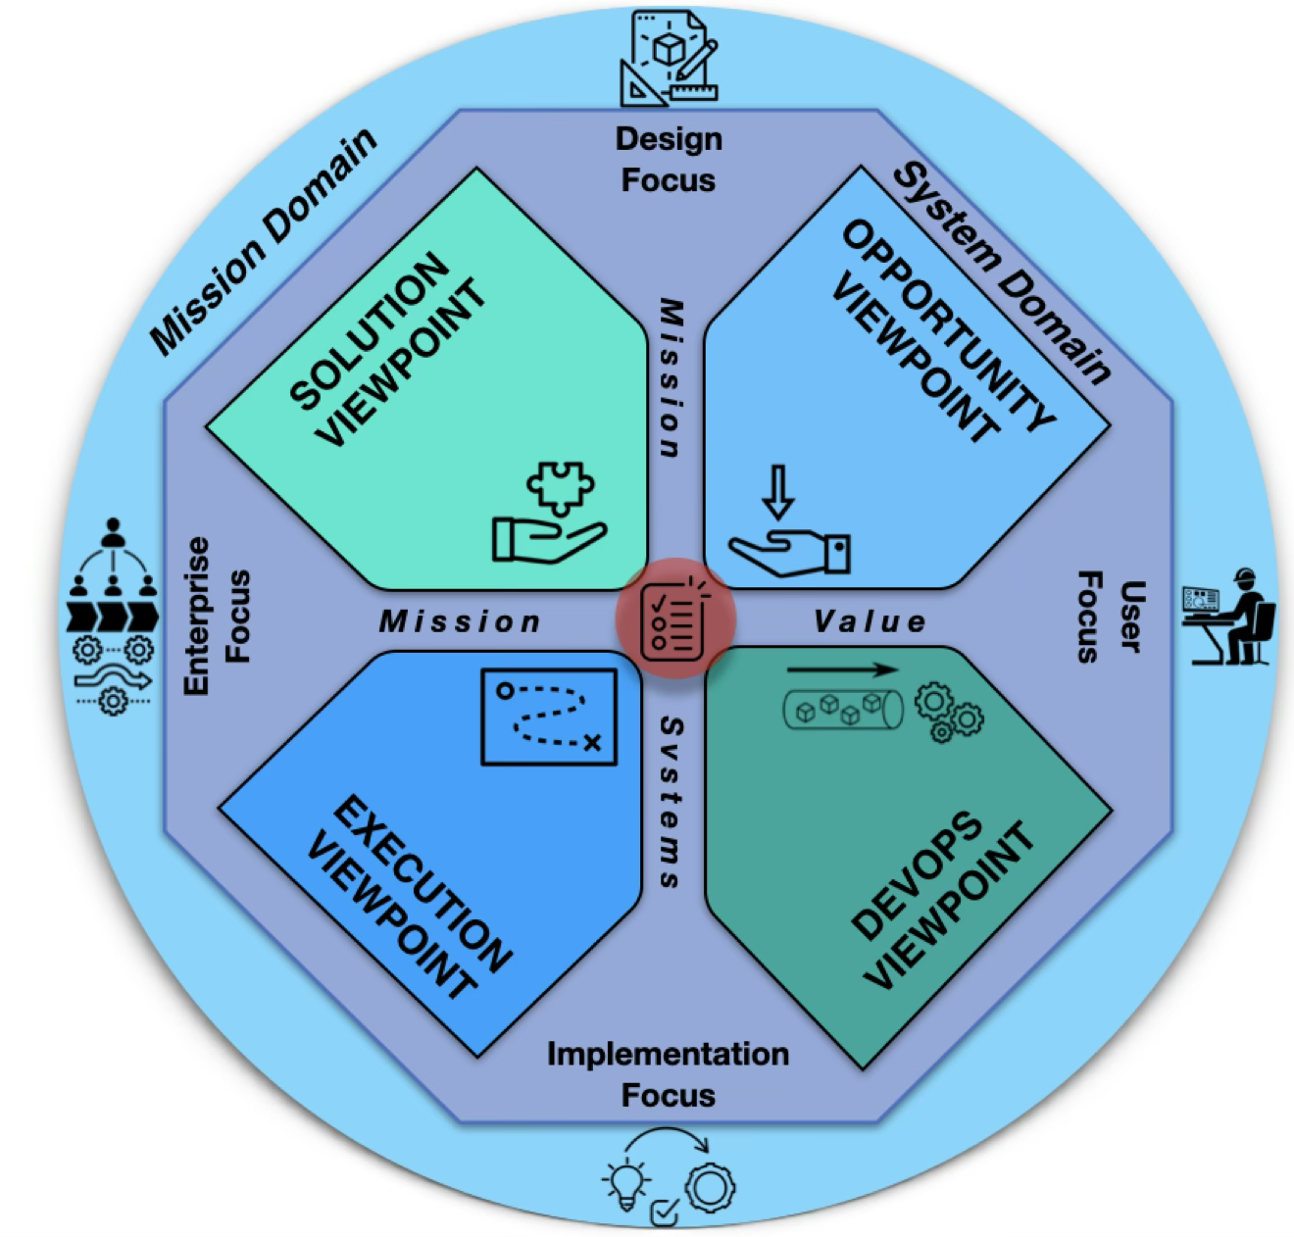
Track #
MBSE-CON 2025 PRESENTATION
The Lifecycle Modeling Framework:
Organizing and Simplifying the Application of Model-Based Systems Engineering
April, 2025
Dr. Jerry Jon Sellers
Teaching Science and Technology Inc.

Slide 2
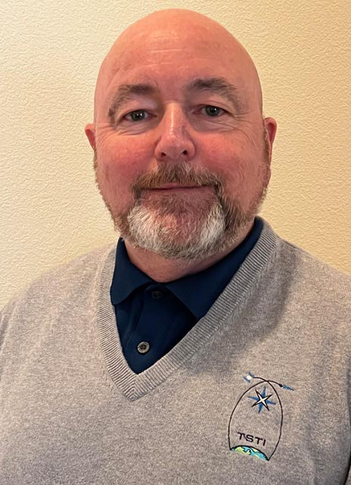
Author’s Bio
Dr. Jerry Sellers, Ph.D., University of Surrey, UK (jsellers@tsti.net)
Partner and President, TSTI with over 30 years of aerospace engineering experience, including Space Shuttle Mission Controller, NASA/JSC, and Chief of Astronautics for the European Office of Aerospace Research and Development, London, UK
Former Director of the Space Systems Research Center, USAF Academy. Responsible for designing, building, testing and operating small, scientific satellites.
Author of the text Understanding Space: An Introduction to Astronautics, Editor and contributing author of the text Applied Space Systems Engineering
Adjunct Professor, Stevens Institute of Technology. Adjunct Professor, Georgetown University
Certified Agile/Scrum Master, Certified Scaled Agile Framework (SAFe) Program Consultant (SPC6)
Elected Member - International Academy of Astronautics, Associate Fellow--AIAA
About Teaching Science and Technology (TSTI) (www.tsti.net)
Small veteran-owned business started in 1995 to teach short courses in space systems engineering
We present ~80 courses a year (live or virtual) to NASA, DoD, ESA and Industry
Partner in Stevens Institute of Technology’s Space Systems Engineering graduate certificate and degree programs

Slide 3
Objectives and Agenda
The Lifecycle Modeling Framework
Objectives
At the end of this presentation you should be able to…
Understand the key elements of the Lifecycle Modeling Framework and its applications
Agenda
The Lifecycle Modeling Framework
Recent Applications

Slide 4
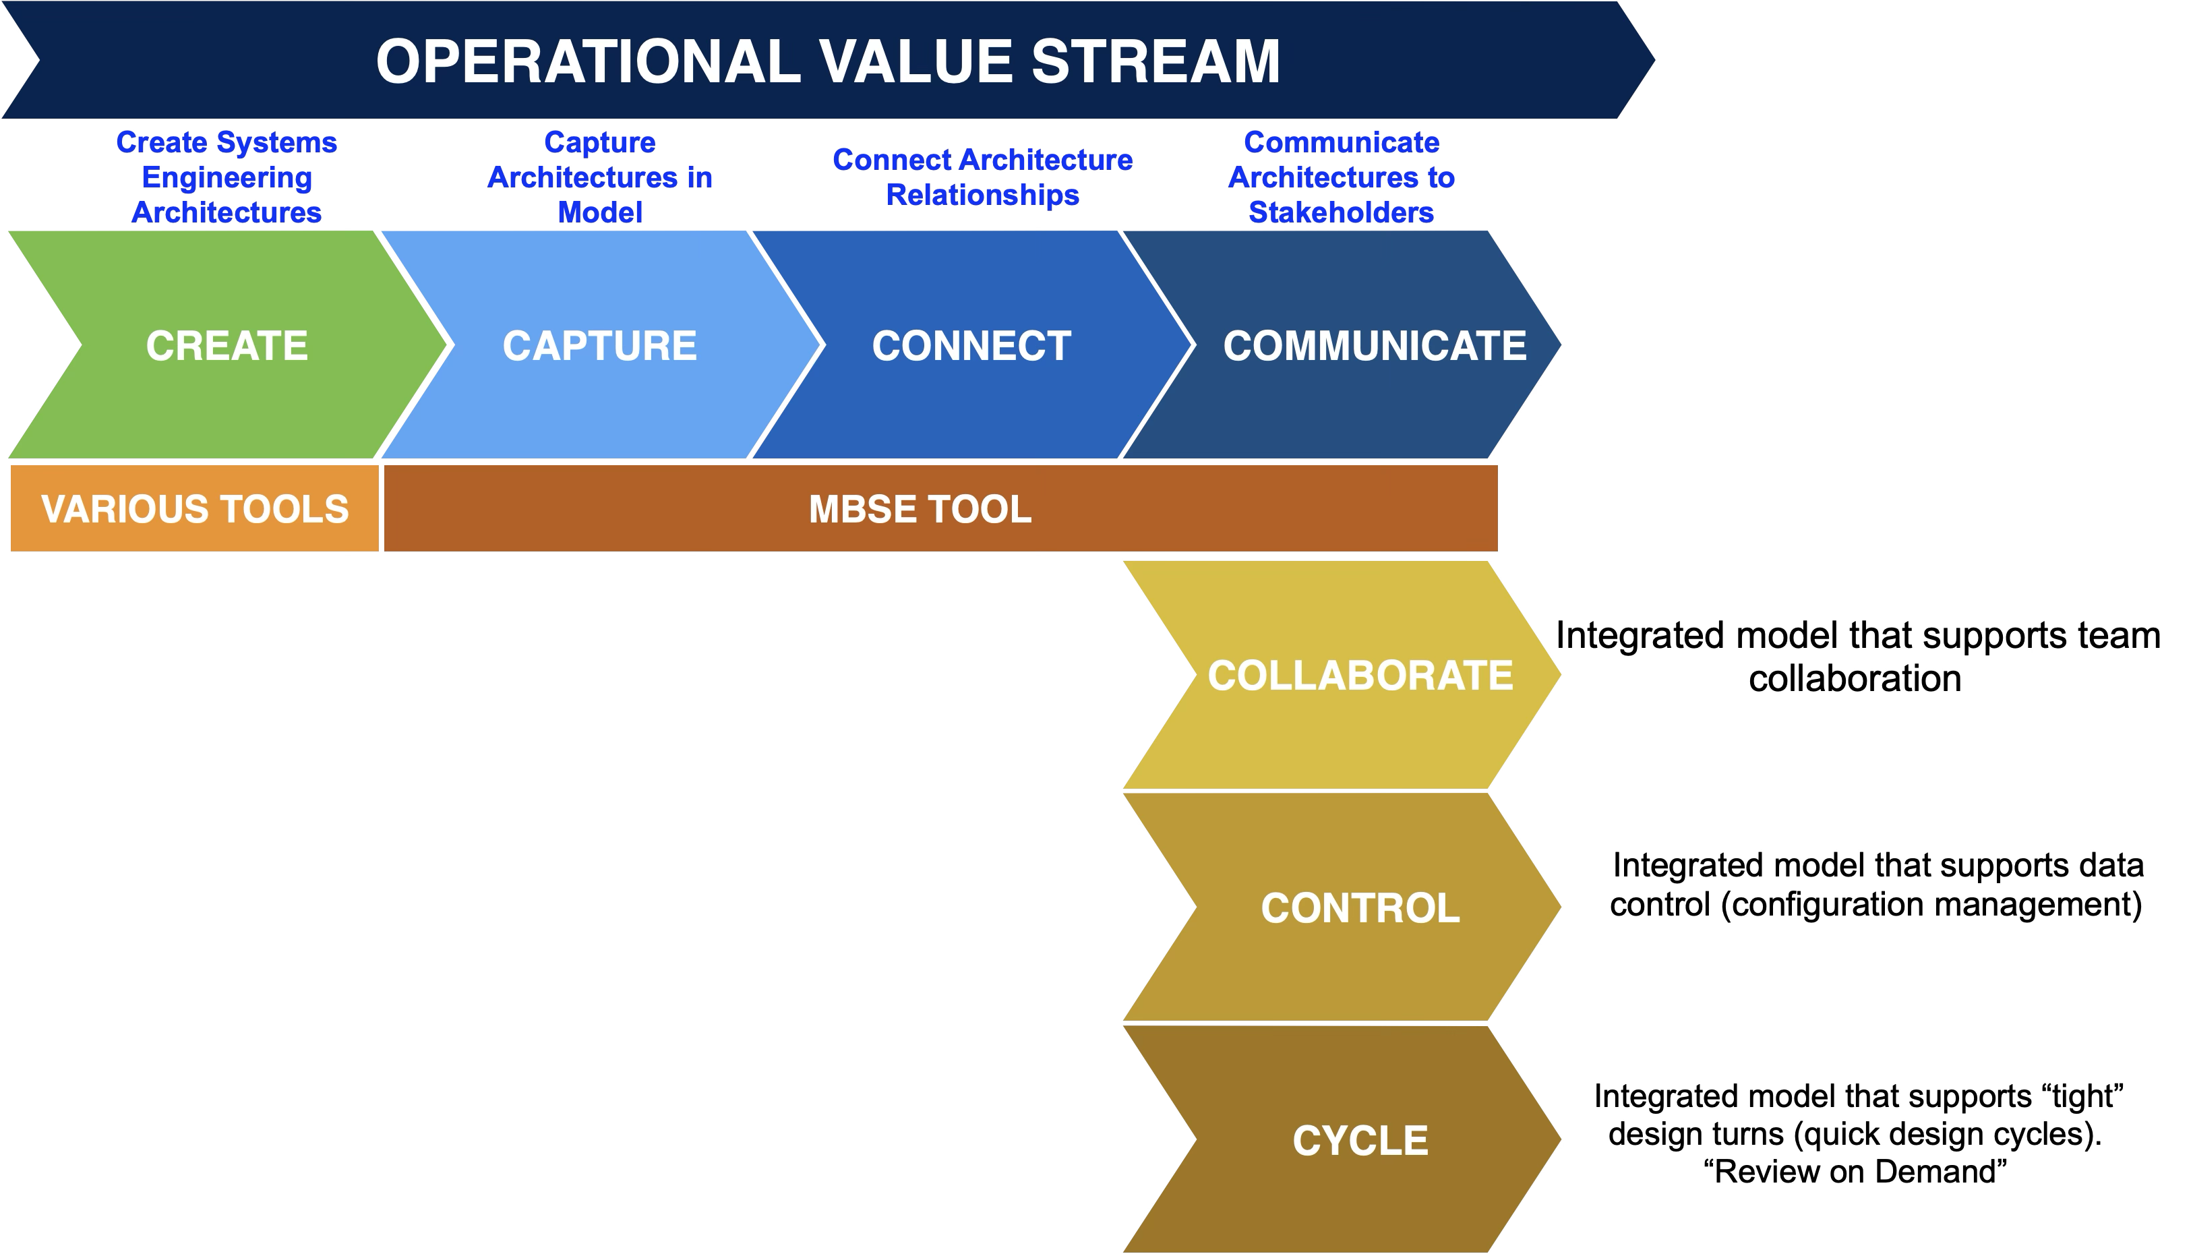
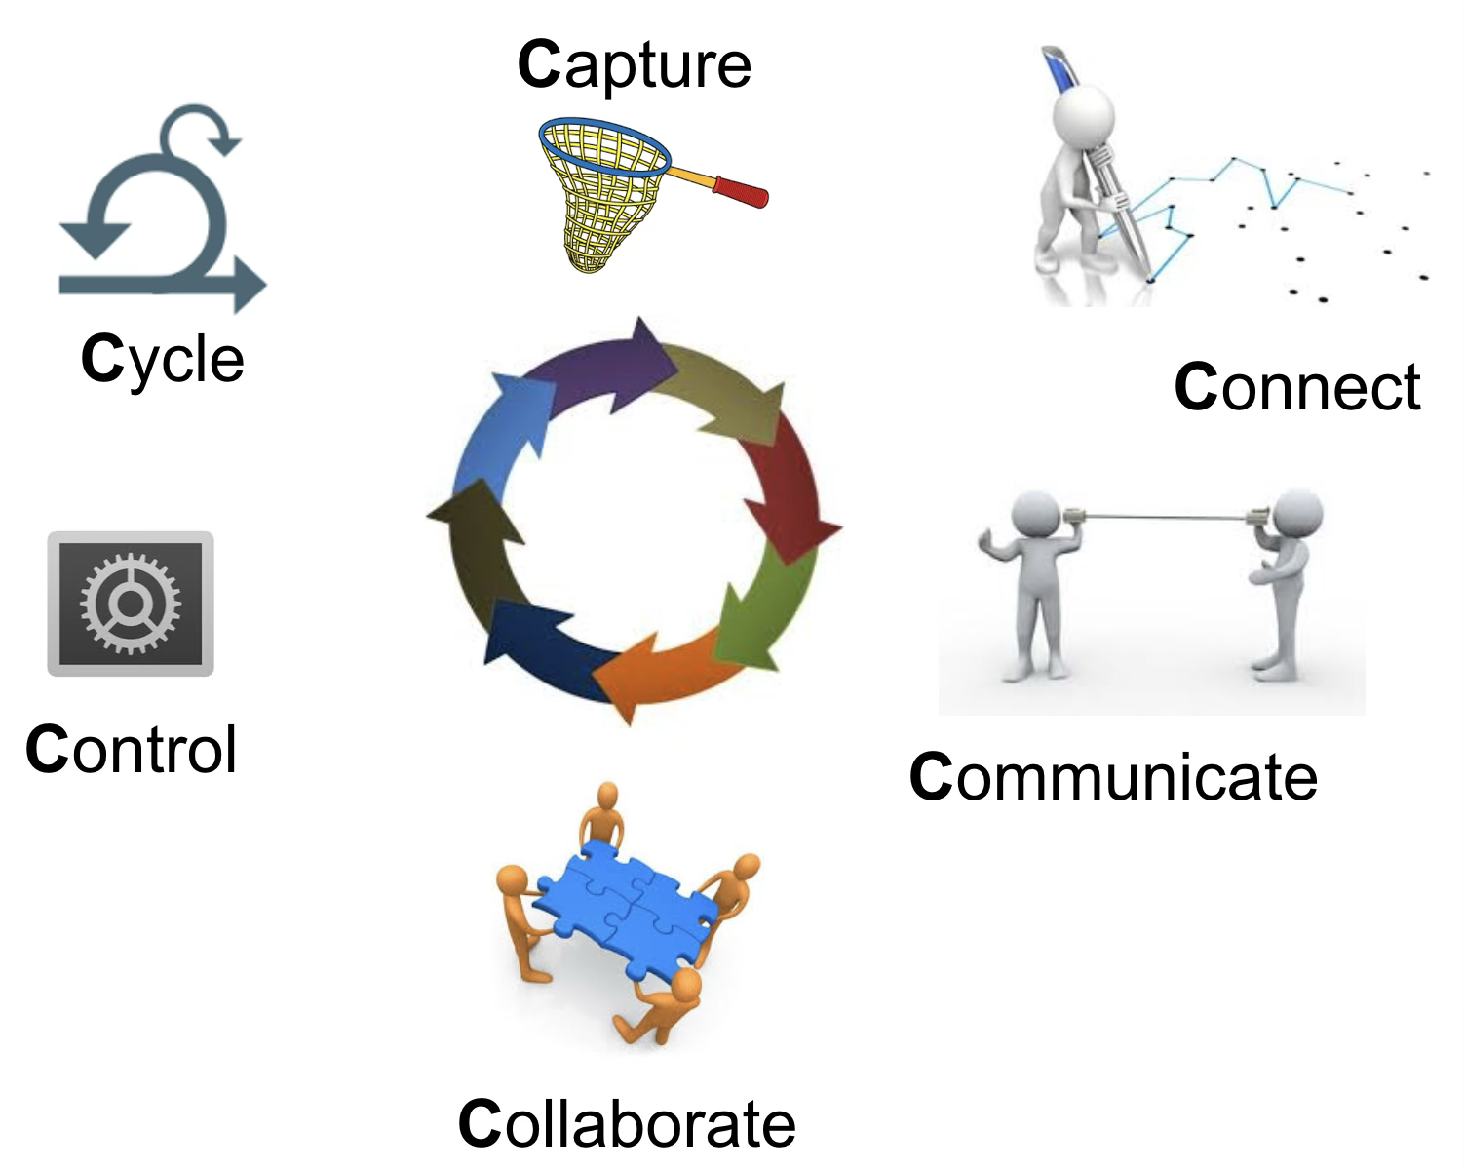
MBSE Value Proposition
The Lifecycle Modeling Framework

Slide 5
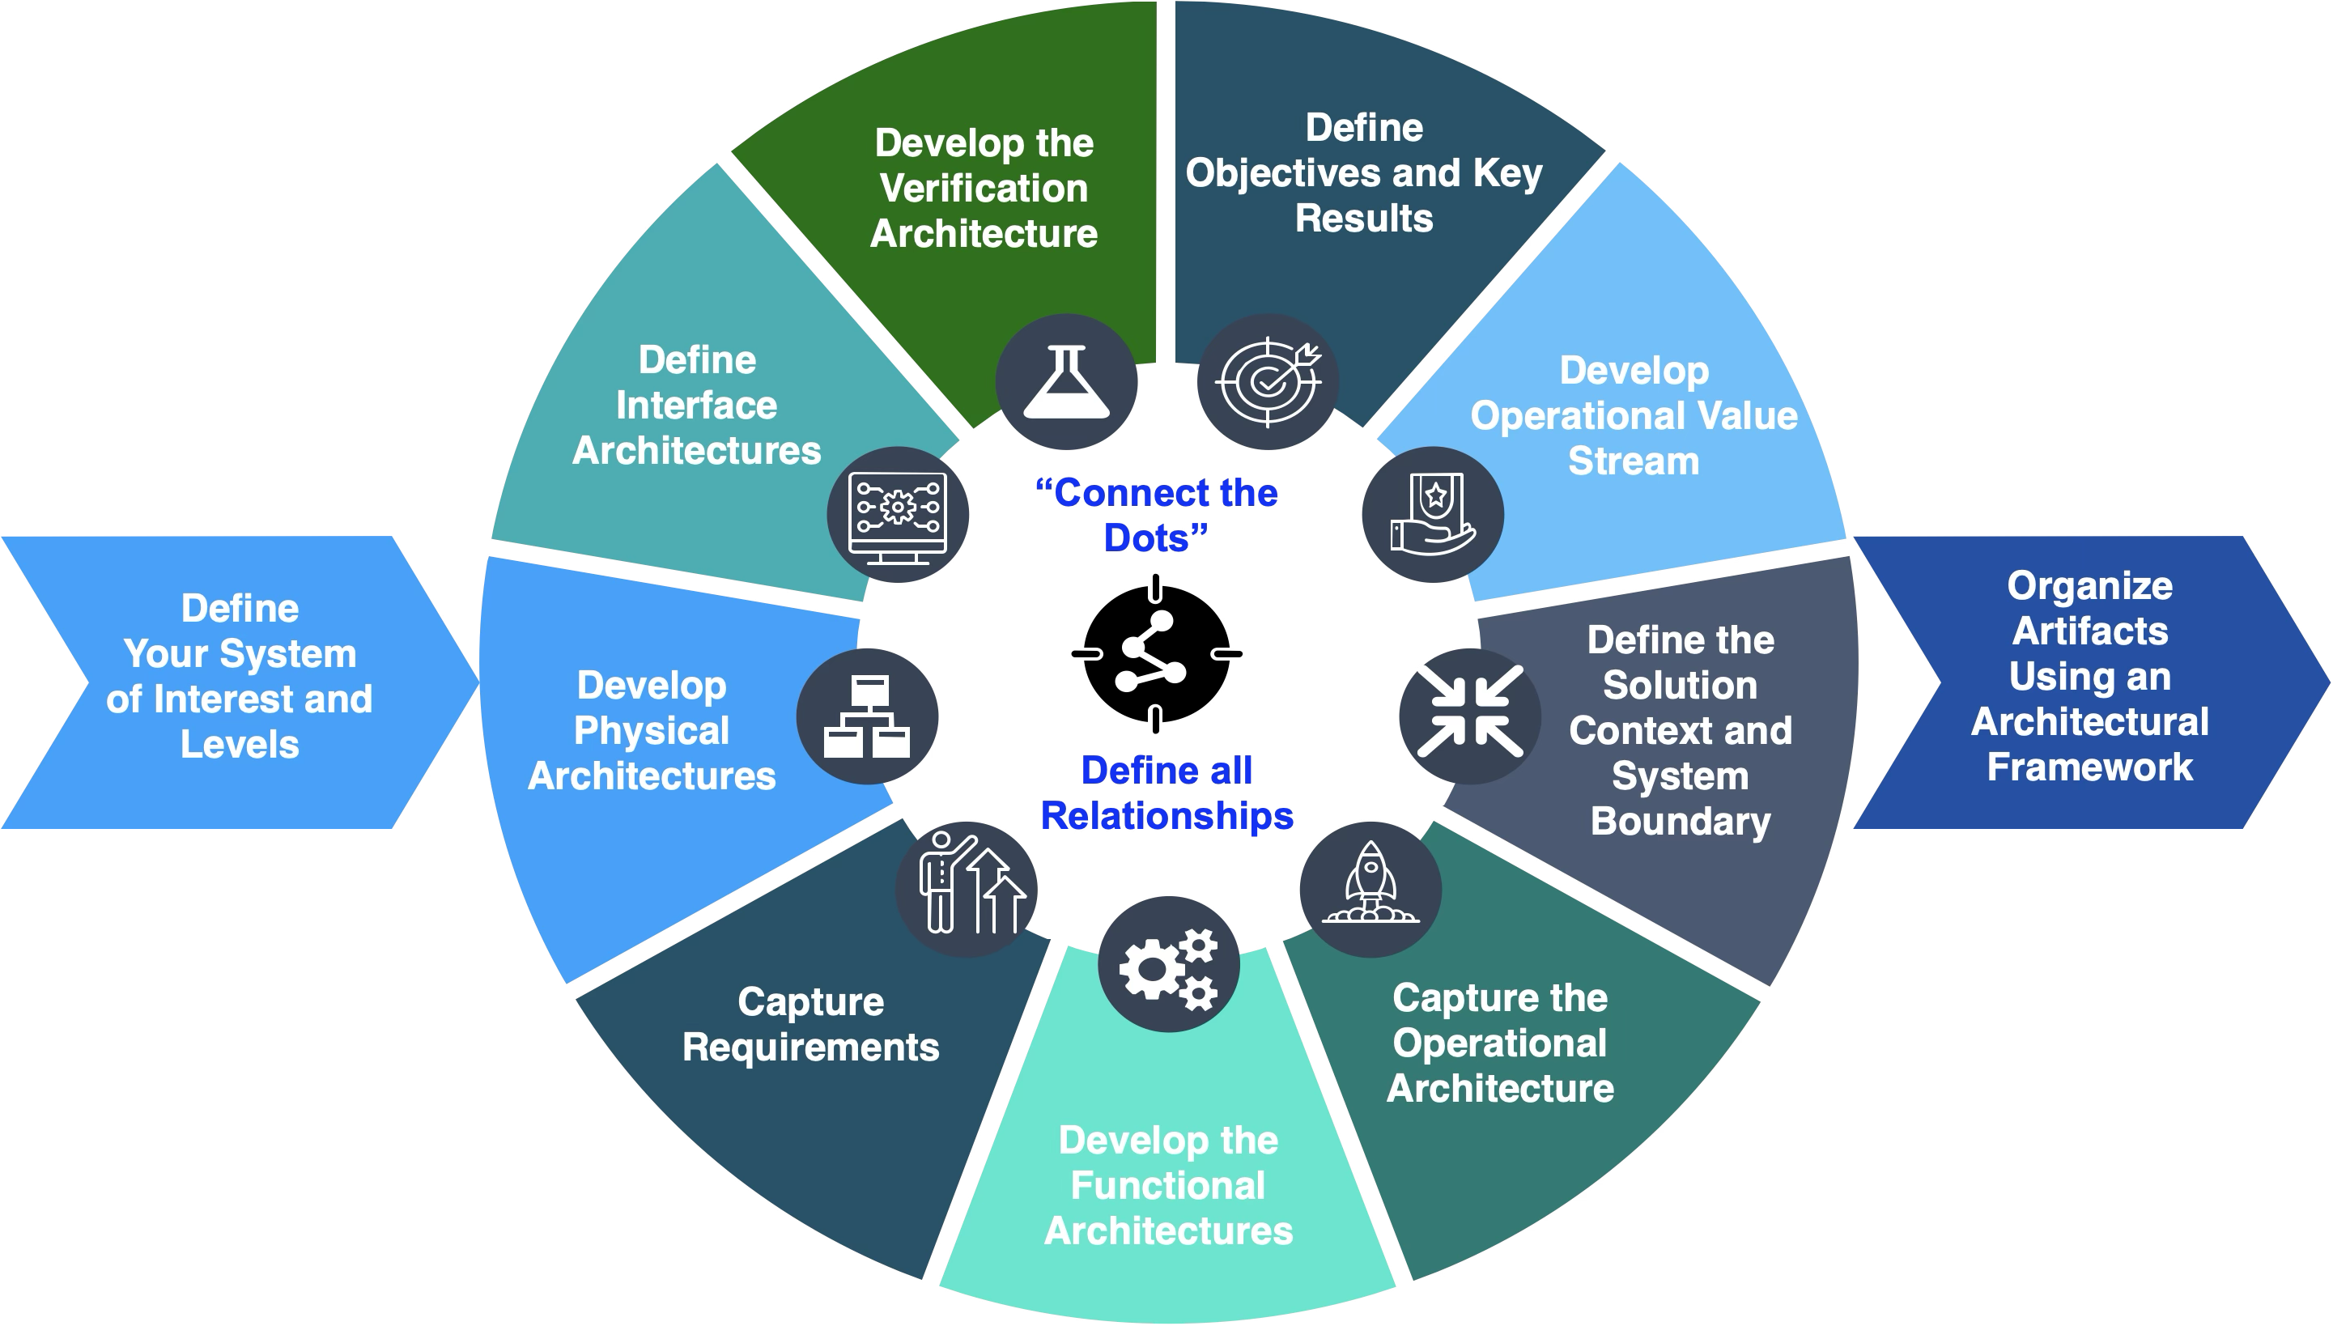
System Modeling Tasks
The Lifecycle Modeling Framework

Slide 6
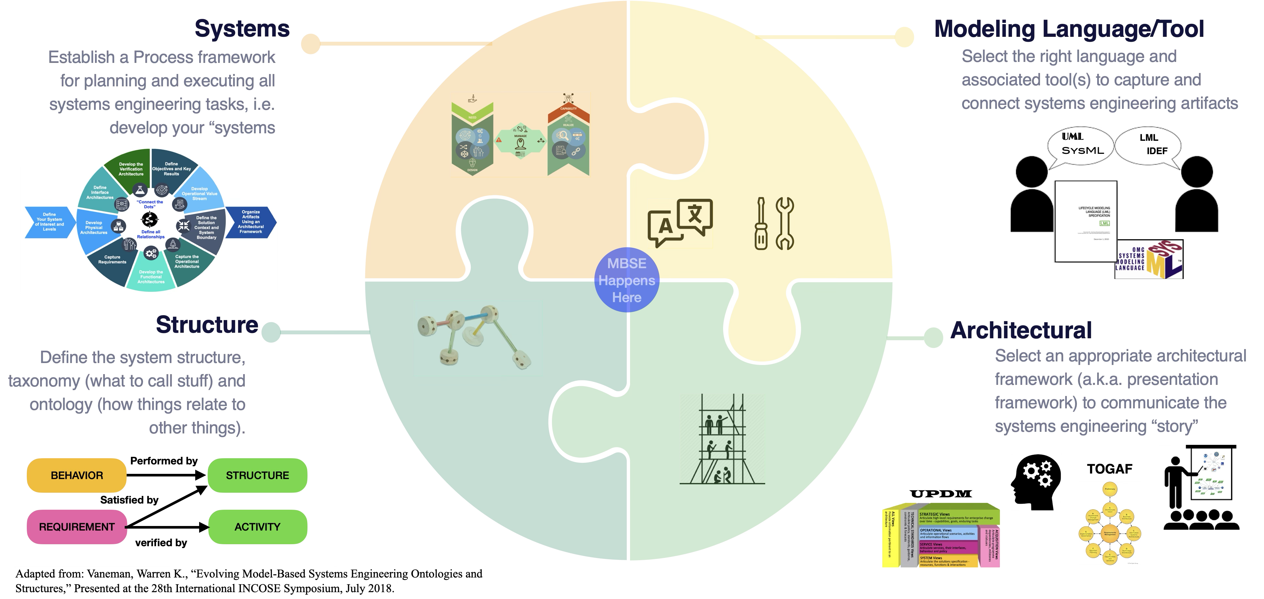
Start Up Checklist
The Lifecycle Modeling Framework

Slide 7

The Lifecycle Modeling Framework
The Lifecycle Modeling Framework (LMF)

Slide 8
Lifecycle Modeling Framework—Motivation
The Lifecycle Modeling Framework
Existing frameworks have limitations when it comes to MBSE
Few new projects start with a completely blank sheet of paper
Often implementation and operations are already largely (or completely) fixed by the solution context
They do not directly tie to MBSE
They tend to be tied to waterfall schedules
They tend to be design focused, not accommodating the full lifecycle
Goals of the Lifecycle Modeling Framework (LMF):
Simple—The LMF should have a relatively small number of total views needed to fully describe the framework.
Flexible—The LMF should applicable to almost any modeling task, technical domain or project management method (e.g. waterfall or agile).
Compatible—The LMF views should be readily definable using common modeling artifacts (e.g. use case diagrams, asset diagrams, etc.)
Comprehensive—The LMF should cover the full lifecycle from cradle, to development to operations (DevOps) to disposal
Measurable—The LMF should include built-in maturity and assessment metrics to guide what part of the frameworks should be completed when and to what level of fidelity to help answer the question “are we done yet?”
Inclusive—The LMF should accommodate views from other AFs providing a “place” these can logically reside.
Agile—You should be able to enter the LMF from any point in the development or operations lifecycle. You should not have to “start in Phase A only,” but be able to apply it to ongoing DevOps activities.

Slide 9
Lifecycle Modeling Framework—Motivation
The Lifecycle Modeling Framework
The framework is comprised of two broad domains…
Mission Domain— Provides the context for Who, What, Where, Why, How, the mission value is created and realized. New missions or new product development initiatives start here. Because it defines the solution context for all systems, the System Domain cannot be completed until the Value Domain is established,
System Domain—Provides the context for all systems engineering processes needed to turn the stakeholders needs into capabilities that delivers value including designing, building, testing and delivering all systems that enable the delivery of value to users.
…and two spanning architectures
Mission Value Stream—Answers the question “what does it (the system together with the enterprise) do?” This functional architecture connects the Enterprise to the Users and defines the sequence of capabilities needed to deliver value to users/customers for a specific mission area (and return some form of compensation to the Enterprise in turn, in some cases indirectly e.g. government projects)
Mission Systems—Answers the question “what is it (the system)?” This physics architecture connects Design to Implementation highlighting the top-down nature of system design and the bottom-up nature of system implementation
Central to the overall Framework is the Assessment Viewpoint
This is the “bull’s eye” of the target, the “bottom line” for ensuring that all efforts in both the mission and product domains are accomplished while delivering on cost, schedule, performance and risk expectations

Slide 10

Lifecycle Modeling Framework—Mission Domain
The Lifecycle Modeling Framework
The Mission Domain includes four key focus areas
Enterprise Focus—serves as the focal point for concerns of the organization(s) undertaking the mission. This includes:
Enterprise Architecture that organizes people, processes and things needed to execute the mission across the lifecycle
Enterprise strategic themes (e.g. high level NASA science goals)
Note that the Solution and Execution Viewpoints naturally “focus” on the Enterprise
Design Focus—the focal point for design concerns including:
Design infrastructure such as conceptual design labs, software tools, prototyping labs, and the people needed to use them
Technology, especially an understanding and access to enabling mission technologies as defined by Technology Readiness Level (TRL)
Note that the Solution and Opportunity Viewpoints naturally “focus” on Design
User Focus—the focal point for all aspects of the user/customer experience including
Transitions of products to users
Ongoing Operations support
Continuous delivery of upgrades and new capabilities as needed
Note that the Opportunity and DevOps Viewpoints naturally “focus” on the User
Implementation Focus—the focal point for all activities and infrastructure needed to turn a design into a product, including:
Procurement
Manufacturing infrastructure
Integration and Test facilities
Note that the Execution and DevOps Viewpoints naturally “focus” on Implementation
NOTE: All focus areas that comprise the Mission Domain should be defined/modeled (or at least a plan to define/model them) prior to the start of Product Domain modeling. For some detail-focused modeling efforts, the Value Domain may be taken as a given or ignored except for external interfaces.

Slide 11
Lifecycle Modeling Framework—System Domain
The Lifecycle Modeling Framework
The System Domain consists of four viewpoints
Opportunity Viewpoint—looks at the situation from the standpoint of what opportunities does the enterprise have or what problems need to be solved. The emphasis here is what needs to get done not how.
Solution Viewpoint—examines and determine solutions to the problem defined by the opportunity viewpoint. This includes the bulk of engineering design effort needed to define how the problem will be solved or opportunity realized.
Execution Viewpoint—includes the practical, programmatic and enterprise efforts needed to turn good ideas (as defined by the solution perspective) into reality. This includes all aspects of strategic project control and execution needed to put in place the infrastructure and organization that will develop and operate the solution.
DevOps Viewpoint—leverages the capabilities supplied by the execution viewpoint to implement the envisioned solution to deliver value to the user that realizes the opportunity or solves the problem. This involves the tactical aspects of product development (including integration and verification) as well as operations and sustainment.
Evidence for each viewpoint is supported by a variety of modeling products, for example
Opportunity Viewpoint Evidence
Scope Model
Requirements Model
Solution Viewpoint Evidence
Design solution analyses models
Detailed Functional and Physical Architecture Models
Execution Viewpoint Evidence
Cost and Schedule Models
Risk Models
DevOps Viewpoint Evidence
V&V Planning Models
ConOps Models
Viewpoint evidence can be mapped to an organization’s milestone entrance criteria (e.g. NASA NPR 7123.1B)
NOTE: All focus areas that comprise the Mission Domain should be defined/modeled (or at least a plan to define/model them) prior to the start of Product Domain modeling. For some detail-focused modeling efforts, the Value Domain may be taken as a given or ignored except for external interfaces.

Slide 12
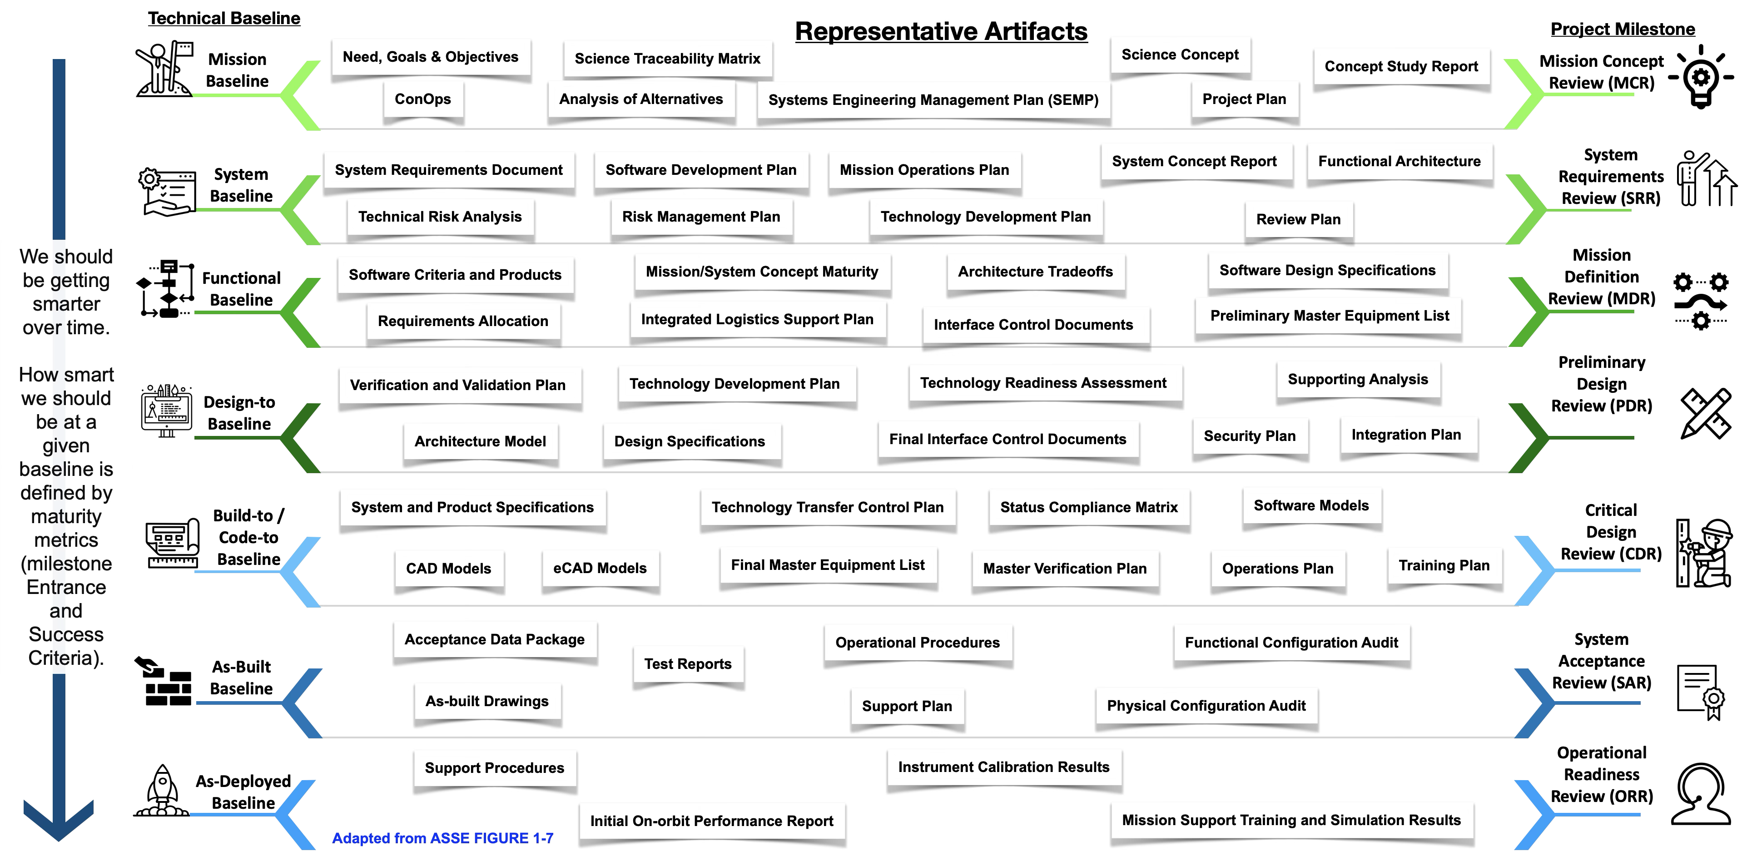
Mapping to Technical Baselines
The Lifecycle Modeling Framework

Slide 13
Technical Baseline Expectations
The Lifecycle Modeling Framework
NASA NPR 7123.1B (and other references) provide detailed guidance on expectations for each technical baseline review
Mission Concept Review | Success Criteria
Entrance Criteria
1. An agenda for the MCR, success criteria, and instructions to the review board have been agreed to by the technical team, the project manager, and the review chair prior to the review. 2. All planned higher level MCRs and peer reviews have been successfully conducted and RID/RFA/Action Items have been addressed with the concurrence of the originators. 3. The following primary products are ready for review: a. **Stakeholders have been identified and stakeholder expectations have been defined and are ready to be baselined after review comments are incorporated. b. **The concept has been developed to a sufficient level of detail to demonstrate a technically feasible solution to the mission/project needs and is ready to be baselined after review comments are incorporated. c. **MOEs and any other mission success criteria have been defined and are ready to be approved. 4. Programmatic products are ready for review at the maturity levels stated in the governing program/project management NPR. 5. Other technical products (as applicable) for hardware, software, and human system elements have been made available to the cognizant participants prior to the review: a. *Mission/project goals and objectives that are ready to be baselined after review comments are incorporated. b. Alternative concepts that have been analyzed and are ready to be reviewed. c. *Initial risk-informed cost and schedule estimates for implementation. d. Preliminary mission descope options. e. *A preliminary assessment performed by the team of top technical, cost, schedule, and safety risks with developed associated risk management and mitigation strategies and options. f. *Preliminary approach to verification and validation for the selected concept(s). g. *A preliminary SEMP, including technical plans. h. * Technology Development Plan that is ready to be baselined after review comments are incorporated. i. *Initial technology readiness that has been assessed and documented with technology assets, heritage products, and gaps identified. j. Preliminary engineering development assessment and technical plans to achieve what needs to be accomplished in the next phase. k. Conceptual life-cycle support strategies (logistics, manufacturing, and operation). l. Software criteria and products, per NASA-HDBK-2203, NASA Software Engineering Handbook. | 1. Mission objectives are clearly defined and stated and are unambiguous and internally consistent. 2. The selected concept(s) satisfactorily meets the stakeholder expectations. 3. The mission is feasible. A concept has been identified that is technically feasible. A rough cost estimate is within an acceptable cost range. 4. The concept evaluation criteria to be used in candidate systems evaluation have been identified and prioritized. 5. The need for the mission has been clearly identified. 6. The cost and schedule estimates are credible and sufficient resources are available for project formulation. 7. The program/project has demonstrated compliance with applicable NASA and implementing Center requirements, standards, processes, and procedures. 8. TBD and TBR items are clearly identified with acceptable plans and schedule for their disposition. 9. Alternative concepts have adequately considered the use of existing assets or products that could satisfy the mission or parts of the mission. 10. Technical planning is sufficient to proceed to the next phase. 11. Risk and mitigation strategies have been identified and are acceptable based on technical risk assessments. 12. Software components meet the exit criteria defined in the NASA-HDBK-2203, NASA Software Engineering Handbook.

Slide 14


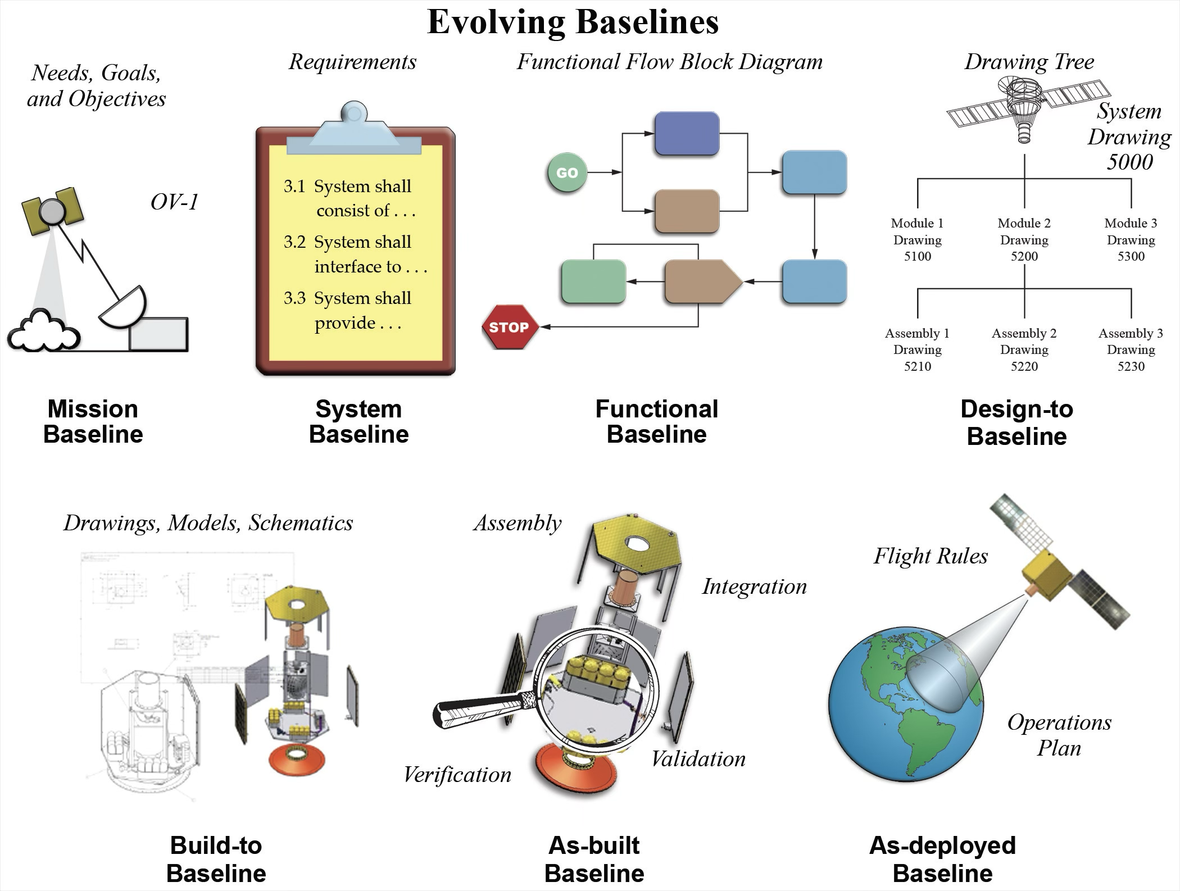

Two Modeling Scenarios
The Lifecycle Modeling Framework
Reverse Modeling (reverse systems engineering) of something that already exists
Forward Modeling (traditional systems engineering—design, manage, realize) of something that does not already exist
Use MBSE as a thinking tool to analyze and model an existing product to capture, connect, communicate and control its ongoing production and/or operations
Use MBSE to guide SE and PM to capture, connect, communicate, collaborate, control and cycle for each technical baseline throughout the entire lifecycle

Slide 15
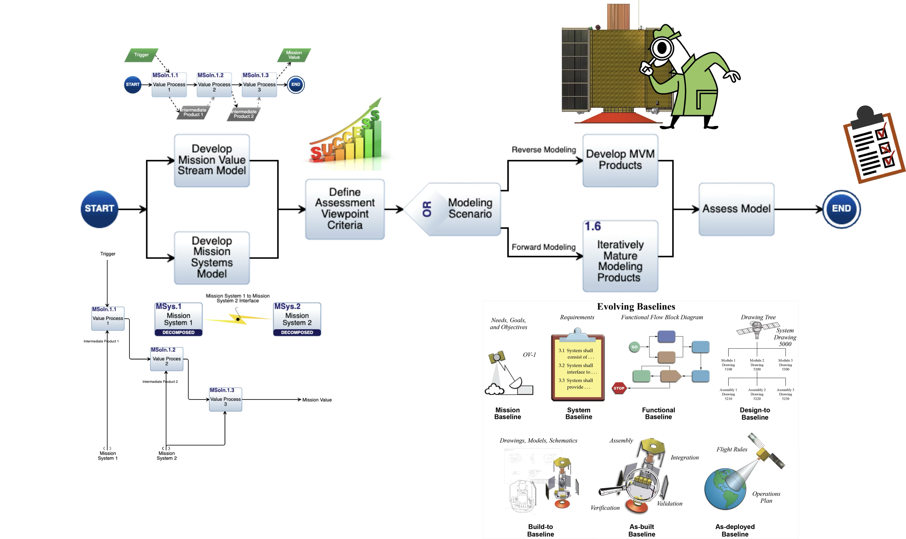
Modeling Approach
The Lifecycle Modeling Framework
MVM = Minimum Viable Model Products

Slide 16
Modeling Products by Viewpoint
The Lifecycle Modeling Framework
Assumes Interfaces to the User Environment, Design Environment, Enterprise Architecture and Implementation Environment are known (or not relevant to the the modeling effort) else these too will need to be modeled. MVM = Minimum Viable Model Products
MVM |  |  | MVM |  |  | MVM
✔︎ | Mission Value Stream Model |  |  |  |  | ✔︎ | Mission Systems Model
 | MP.1 | Opportunity Viewpoint Products |  | MP.3 | Execution Viewpoint Products |  | MP.4 | DevOps Viewpoint Products
 | MP.1.1 | Stakeholders |  | MP.3.1 | Agenda² |  | MP.4.1 | Verification Requirements
✔︎ | MP.1.2 | Scope Definition (OKRs, OV-1) |  | MP.3.2 | Reviews² |  | MP.4.2 | V and V Plan (strategic)²
 | MP.1.3 | System Requirements (incl. KPPs, or Feature/User Story Backlog) |  | MP.3.3 | Budget Estimates² |  | MP.4.3 | V and V Approach (tactical)
 | MP.1.4 | De-scope Options = MVP |  | MP.3.4 | Technical Planning² |  | MP.4.4 | V and V Procedures
 | MP.1.5 | DoDAF Capabilities Views¹ |  | MP.3.5 | Schedule Estimates (IMS or Roadmaps or Kanban)² |  | MP.4.5 | Procurement and Production Plan
 | MP.2 | Solution Viewpoint Products |  | MP.3.6 | WBS² |  | MP.4.6 | V and V Results
 | MP.2.1 | Design Solution Analyses (incl. AoA, TRL assessments) |  | MP.3.7 | Risk Assessment and Mitigation | ✔︎ | MP.4.7 | Operations Concept
✔︎ | MP.2.2 | Detailed Functional Architectures |  | MP.3.8 | Risk Management Plan² |  | MP.4.8 | Operations Plan²
✔︎ | MP.2.3 | Detailed Physical Architectures | ✔︎ | MP.3.9 | Hazard Analysis and Controls |  | MP.4.9 | Training Plan²
 | MP.2.4 | TPMs, Margins and Trends |  | MP.3.10 | Quality Control² |  | MP.4.10 | Support Strategy
✔︎ | MP.2.5 | Interface Architecture (incl. TLM/Cmds) |  | MP.3.11 | Anomaly Resolution² |  | MP.4.11 | Other DoDAF Operational Views¹
 | MP.2.6 | Design Specifications including BOM |  | MP.3.12 | DoDAF Standards Views¹ |  | MP.4.12 | DoDAF Data and Info Views¹
 | MP.2.7 | Drawings and CAD Models² |  | MP.3.13 | DoDAF All Views¹ |  | MP.4.13 | DoDAF Services Views¹
 | MP.2.8 | Transfer functions (parametrics)
 | MP.2.9 | DoDAF System Views¹ |  | MP.3.14 | DodAF Project Views¹
 |  |  | ✔︎ | Assessment Viewpoint Products
¹ Some DoDAF or other AF products obtained “for free” derived from other products shown here.
² These products are typically developed outside of traditional MBSE tools but can then be integrated.

Slide 17

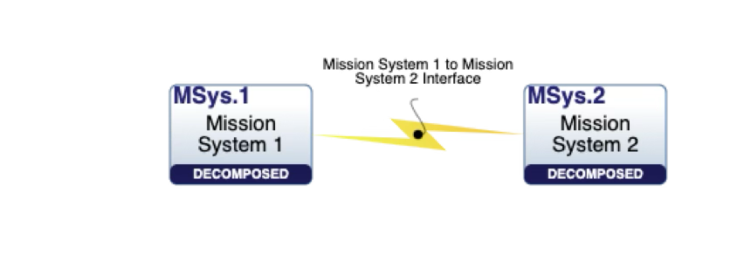
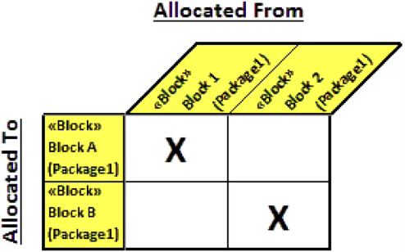
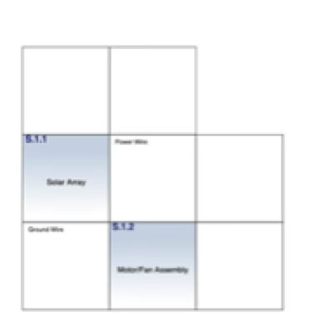
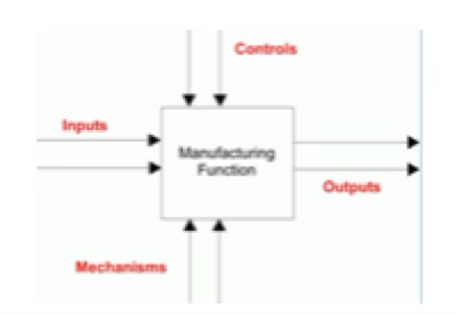
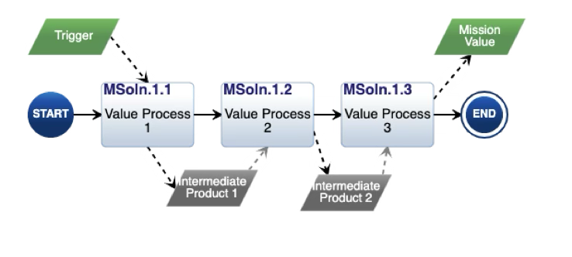
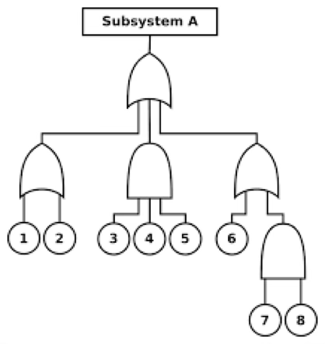
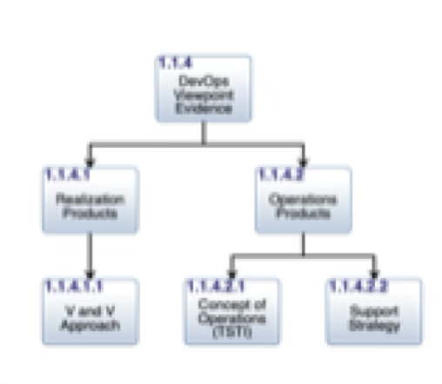
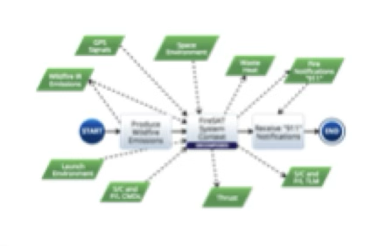
Minimum Viable Model
The Lifecycle Modeling Framework
Minimum Viable Model Products
✔︎ | Mission Value Stream Model
✔︎ | Mission Systems Model
✔︎ | MP.1.2 | Scope Definition (OKRs, OV-1)
✔︎ | MP.2.2 | Detailed Functional Architectures
✔︎ | MP.2.3 | Detailed Physical Architectures
✔︎ | MP.2.5 | Interface Architecture (incl. TLM/Cmds)
✔︎ | MP.3.9 | Hazard Analysis and Controls
✔︎ | MP.4.7 | Operations Concept
✔︎ | Assessment Viewpoint Products
Answers these basic questions..
What does it do?
Mission Value Stream Model
Scope Definition
Detailed Functional Architectures
What is it?
Mission Systems Model
Detailed Physical Architectures
Interface Architecture (incl. TLM/Cmds)
How do I use it?
Operations Concept
How can it kill me?
Hazard Analysis and Controls

Slide 18
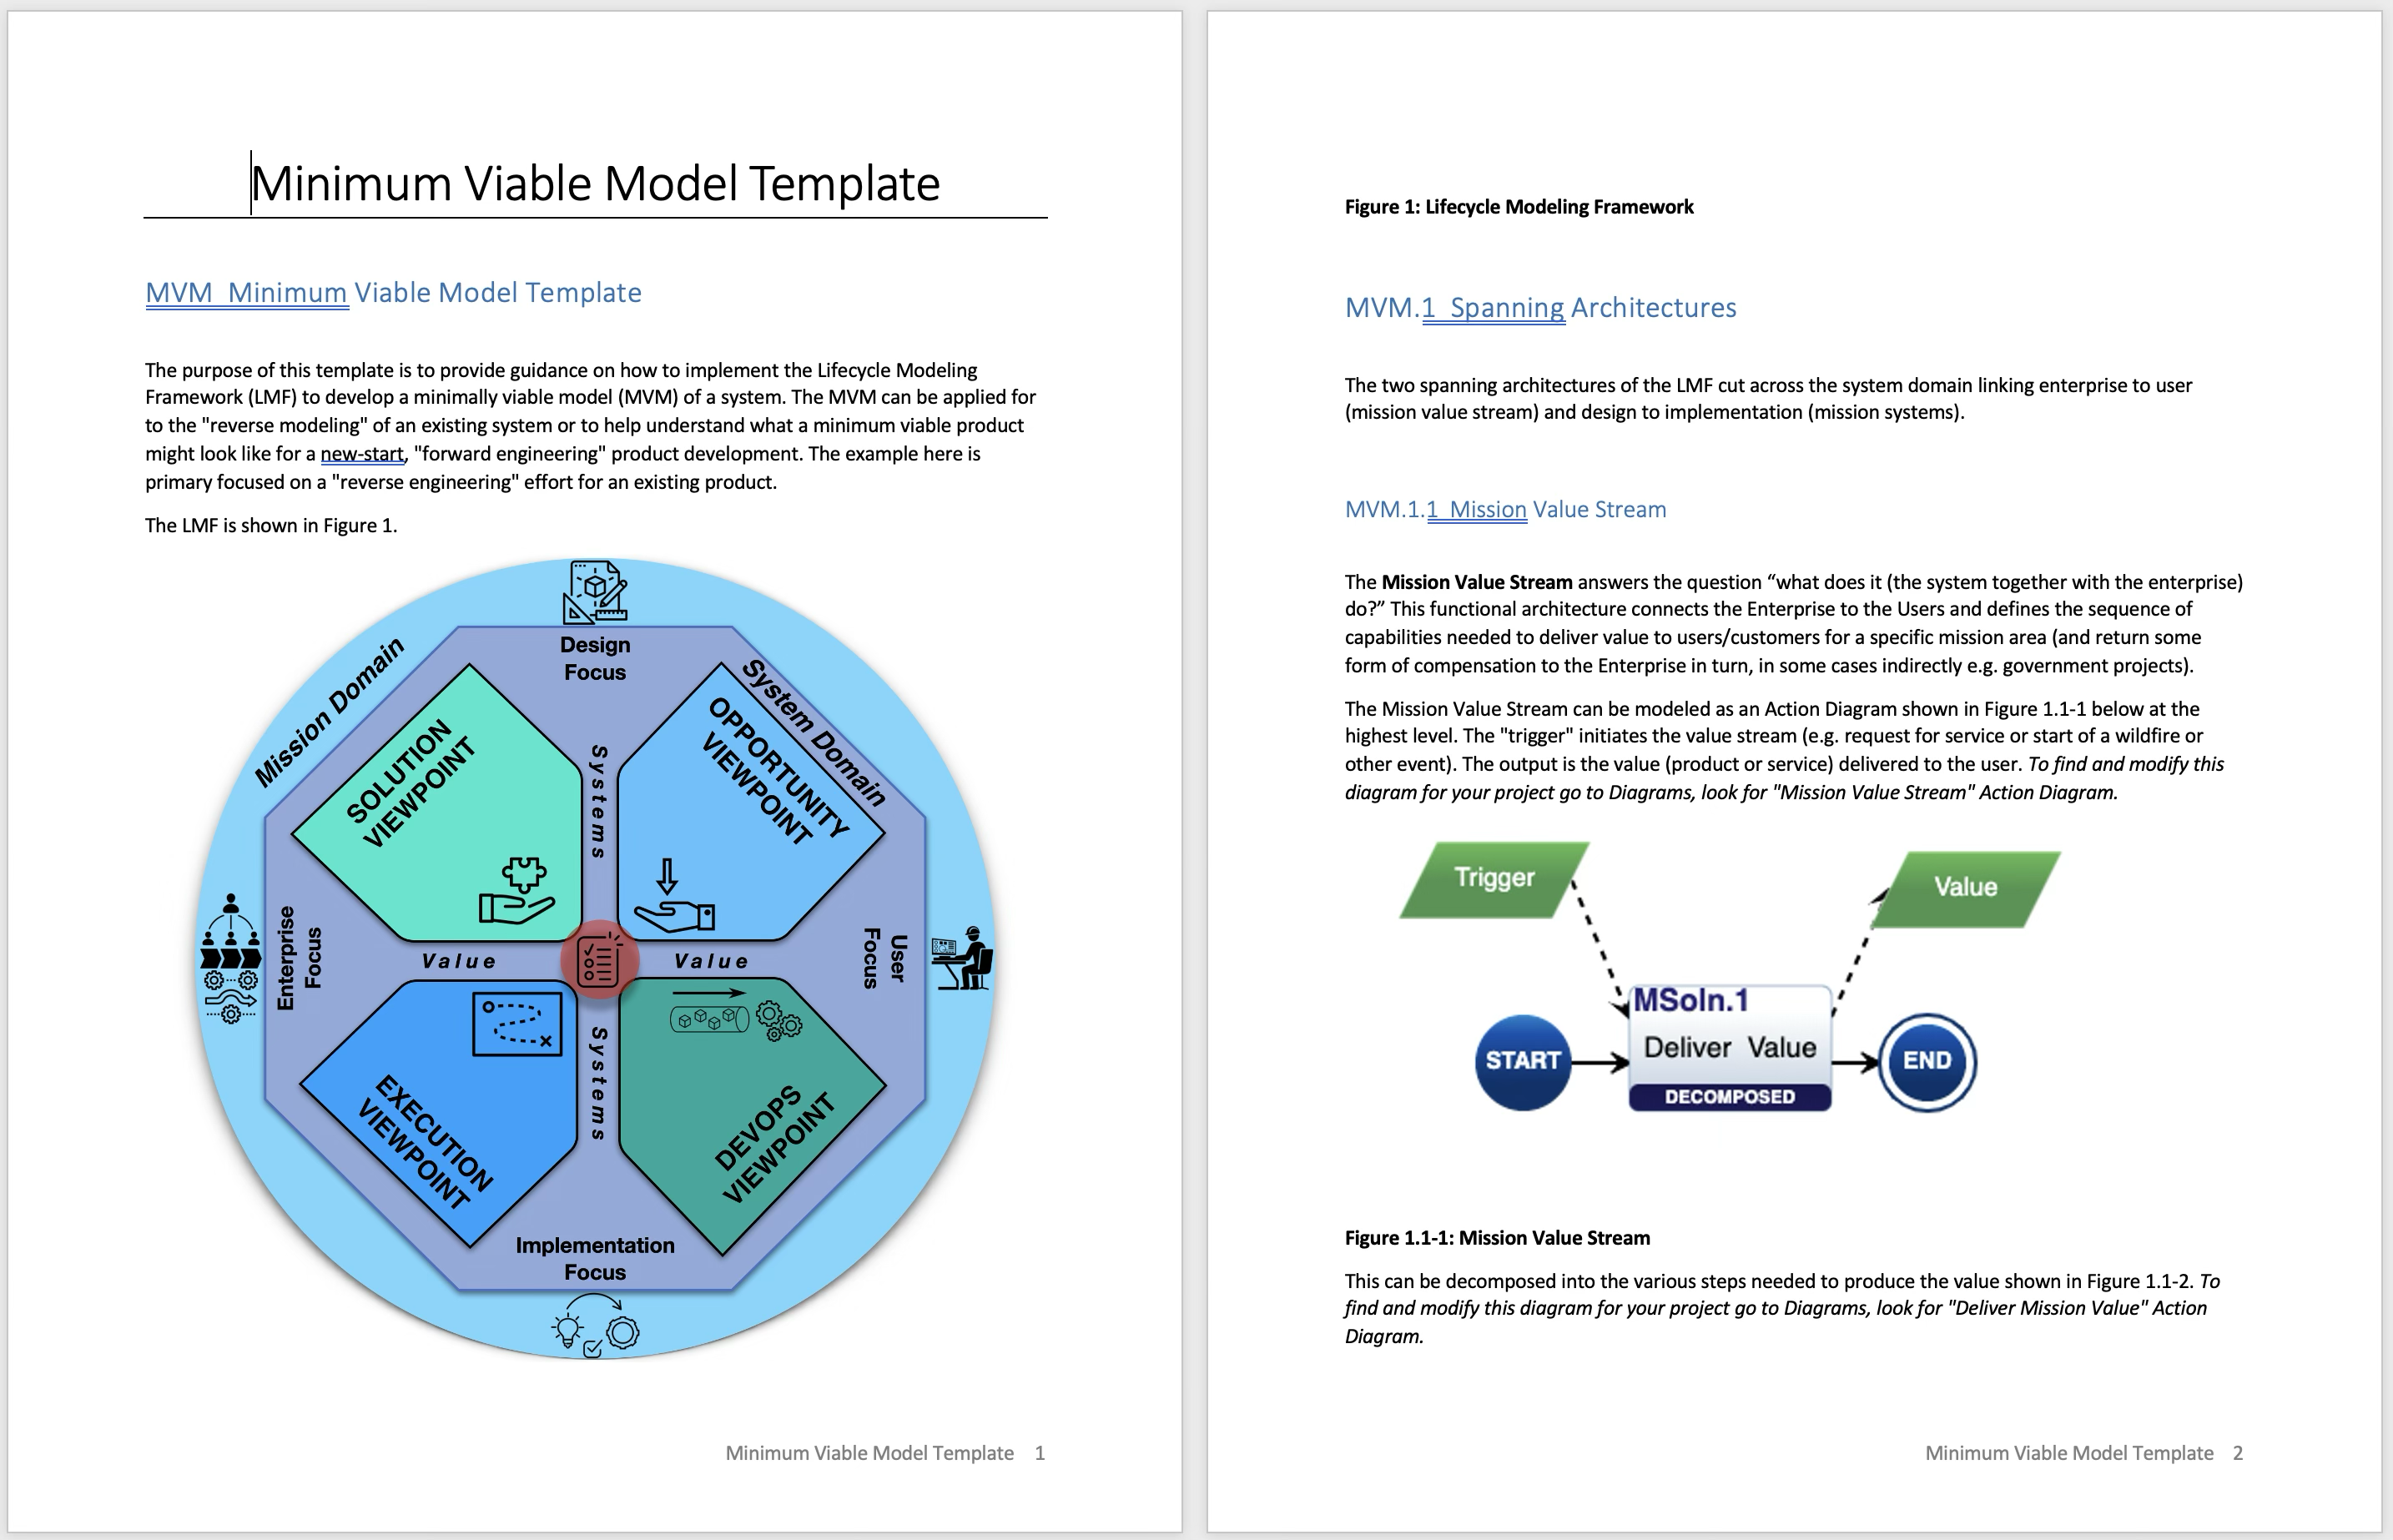
Approach—Minimum Viable Model (MVM) Template Innoslate
The Lifecycle Modeling Framework
A Minimum Viable Model Template was created using the Innoslate MBSE tool
This model “shell” serves as a starting point and guidance for doing a basic system model
“Strawman” model elements are already in place ready to be modified for a specific system of interest
The template then serves as basic system definition report

Slide 19
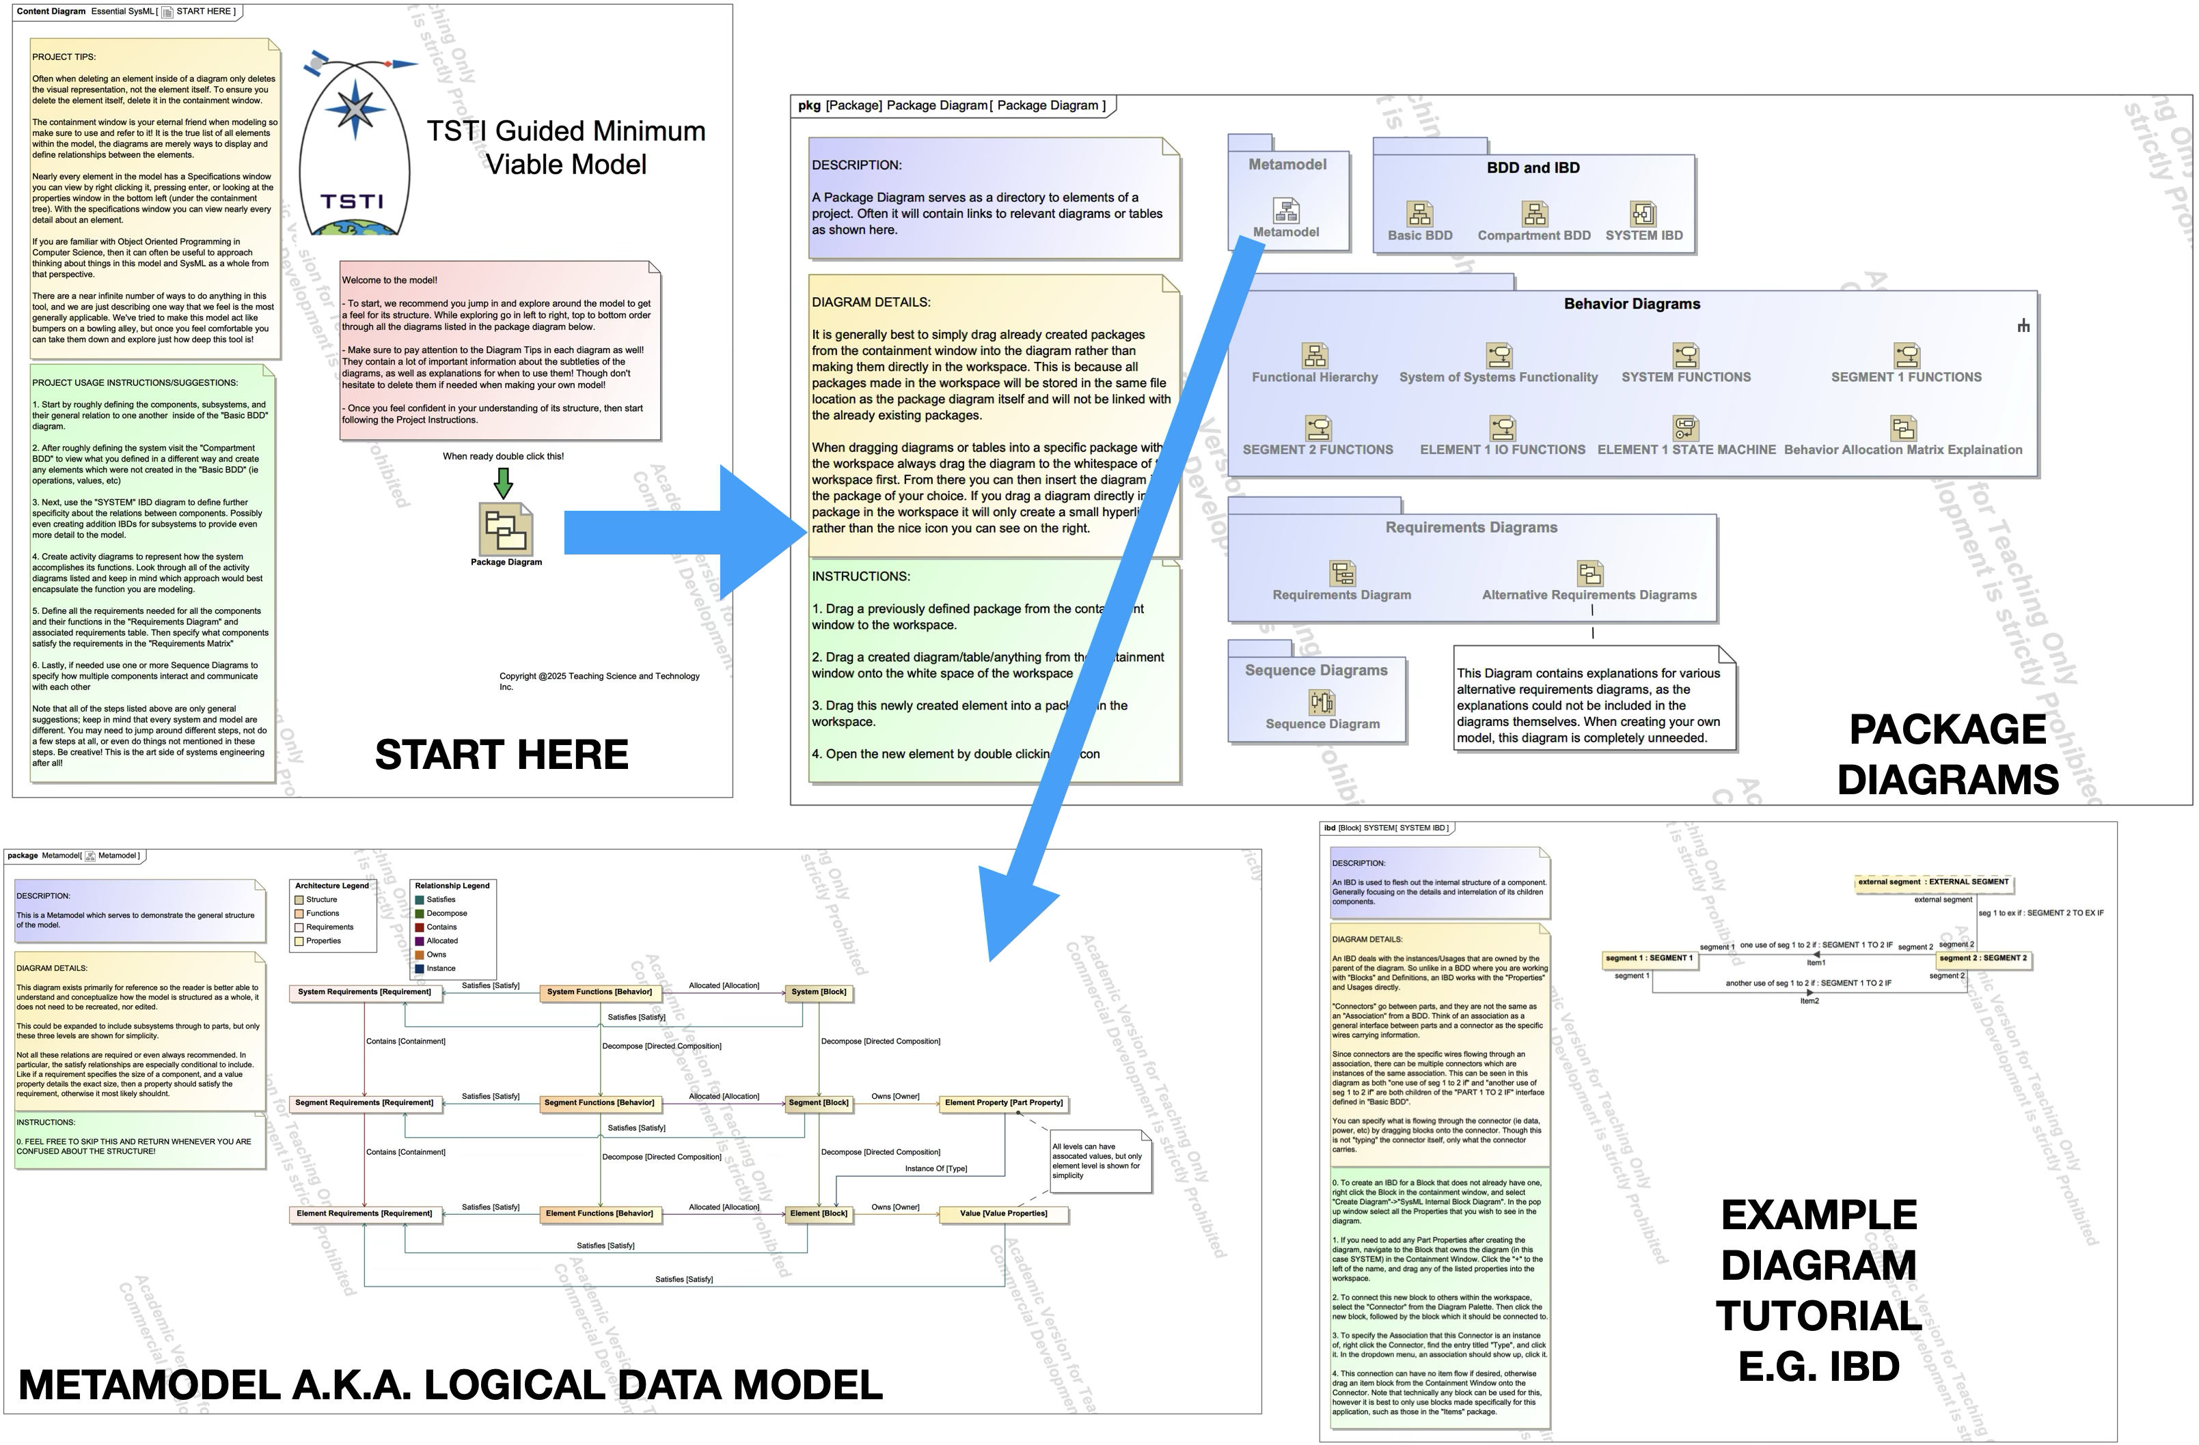
Includes innovative tutorials and how-to guidance on using the tool/language
Approach—Minimum Viable Model (MVM) Template Cameo

Slide 20
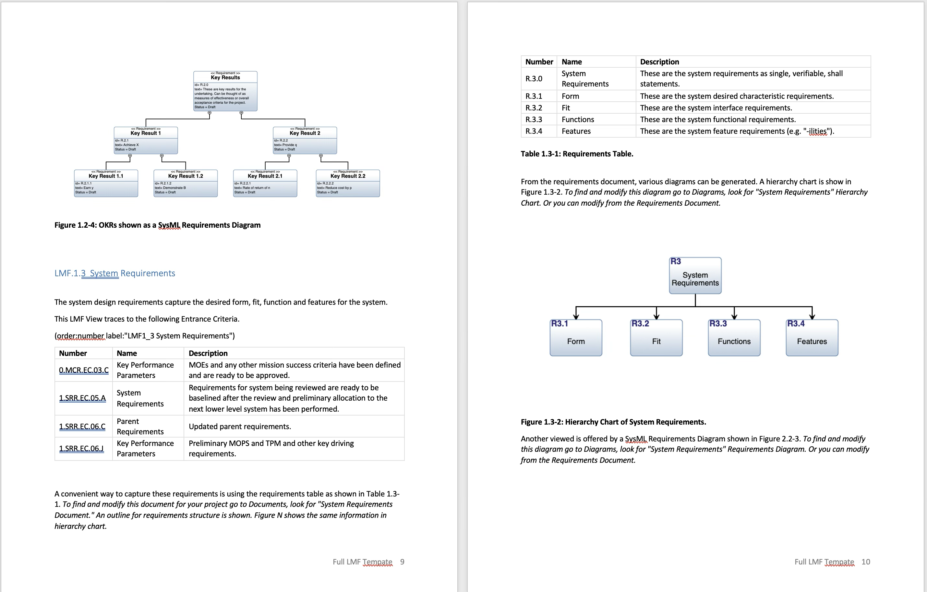
Approach—Full Lifecycle Model (FLM) Innoslate
The Lifecycle Modeling Framework
A Full Lifecycle Template was also created using the Innoslate MBSE tool
This model “shell” serves as a starting point and guidance for doing a complete system model (design through verification, validation and operations)
“Strawman” model elements are already in place ready to be modified for a specific system of interest
The template then serves as complete system definition report
Cameo version in works
Note: In this example, evidence is mapped to NASA NPR 7123.1C entrance and success criteria

Slide 21
The Lifecycle Modeling Framework
Recent Applications

Slide 22
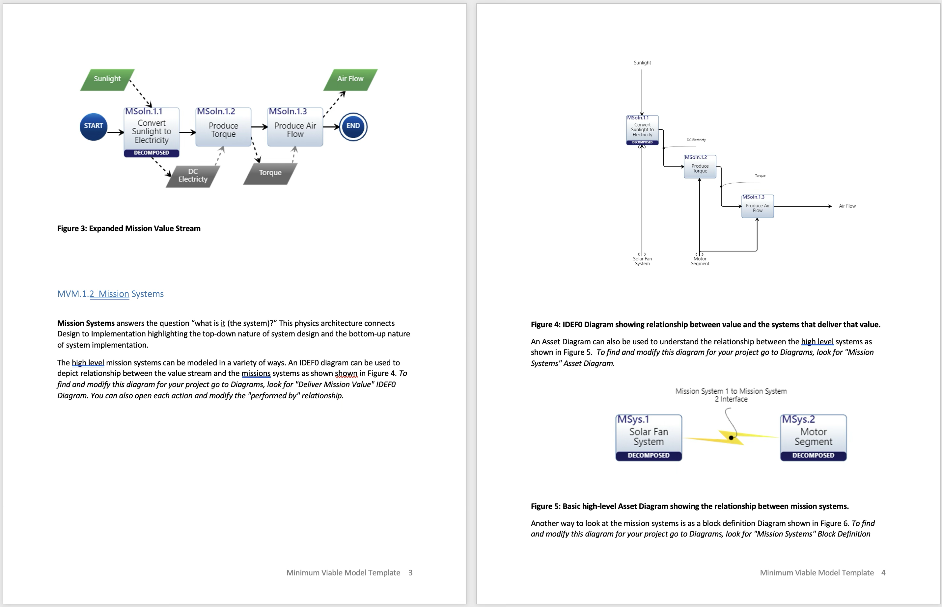
Student Projects - Graduate SE Courses
The Lifecycle Modeling Framework
The LMF MVM template has been used in several different graduate systems engineering courses with great success
Students who are completely new to system architecting and MBSE are able to quickly “jump start” into applying this to specific systems of interest

Slide 23
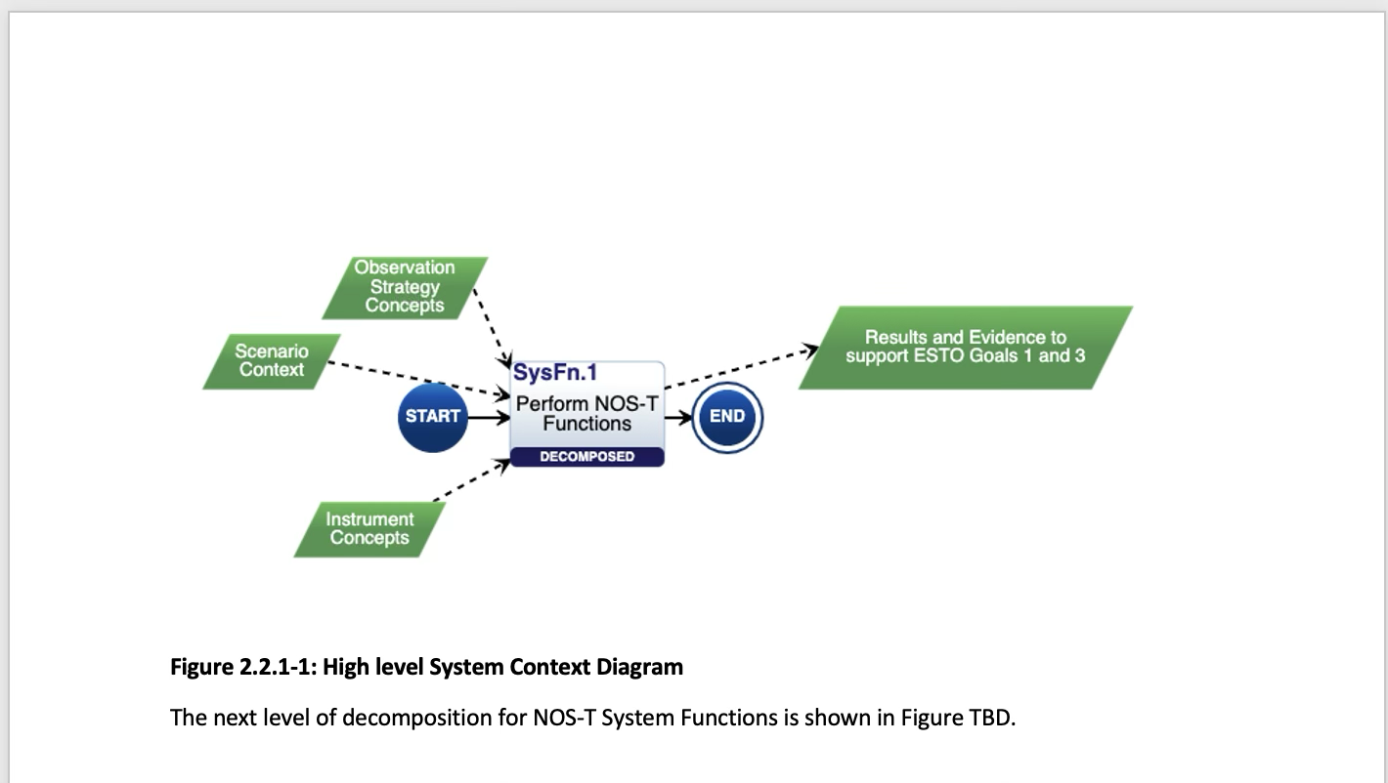
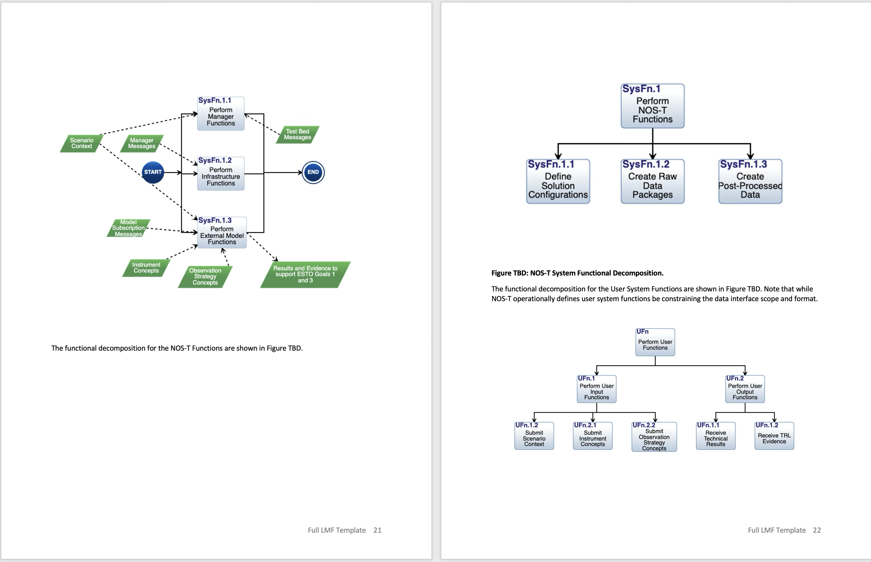
NASA New Observation Strategies Testbed Project
The Lifecycle Modeling Framework
NASA New Observation Strategies Testbed (NOS-T) project is run out of the Systems Engineering Research Center (SERC) at Stevens Institute of Technology
Project started up in August 2020
Using the full LMF template to capture, connect and communicate the overall system design, development, V&V and operations

Slide 24
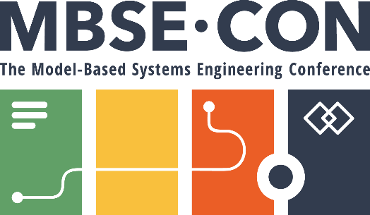

MBSE-CON 2025 PRESENTATION
THANK YOU
It’s time for the Q&A.

